Slide 1
SPSA Evaluation
2021-2022

Slide 2
Objectives
Understand Why the SPSA Evaluation is Required
Learn How to Complete the 21-22 SPSA Evaluation

Slide 3
Annual Review
Per Education Code 64001 the SSC must evaluate the SPSA annually
Review is an integral part of Federal Program Monitoring review
The evaluation provides data to inform and guide future plans/modifications
Evaluating the plan ensures that SPSA has been implemented
Evaluating the plan helps assess if implementation of strategies led to positive effects

Slide 4

Evidence of Evaluation
Schools must keep copies of:
  SSC and ELAC
    Agendas
    Minutes
    Sign-ins (Zoom Usage Reports)
  (Proof that review and recommendations were made during the completing of the evaluation.)
  Copies of documentation for other stakeholder groups if they were part of the evaluation process.
  Keep copies of items shared during the meeting (i.e., power points, data summary sheets, needs assessments, SARC, etc.).
  Completed evaluation on the SPSA platform by October 31, 2022.

Slide 5


Beginning Steps
Gather Data
Allocate time to review data (keep documentation)
Review expenditures for 2021-22 using categorical resources

Slide 6
Multiple Measures
Do not have a narrow focus on data inquiry or rely on one source
  Curriculum-based assessments
  Grades for first semester and possible trends in the second semester
  Local data
  Student work
  Surveys (student, staff, parents)
Think about the strategies in your plan. Were they implemented and what were the results?
  If PD was completed, what happened after the PD?
  If the purpose was to provide students with technology, did the purchase of technology help the gap in student achievement anytime during the year?

Slide 7
Things to Consider …
What were the school’s strategies?
What were the school’s expenditures?
Did you monitor the strategies throughout the year like you indicated in the plan?
What were the results of the strategies, actions, and expenditures?

Slide 8
SPSA
SPSA Evaluation Job Aid

Slide 9
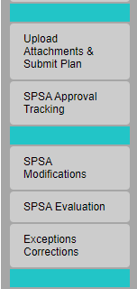
Click the SPSA Evaluation in the left navigation menu, as shown.

Slide 10
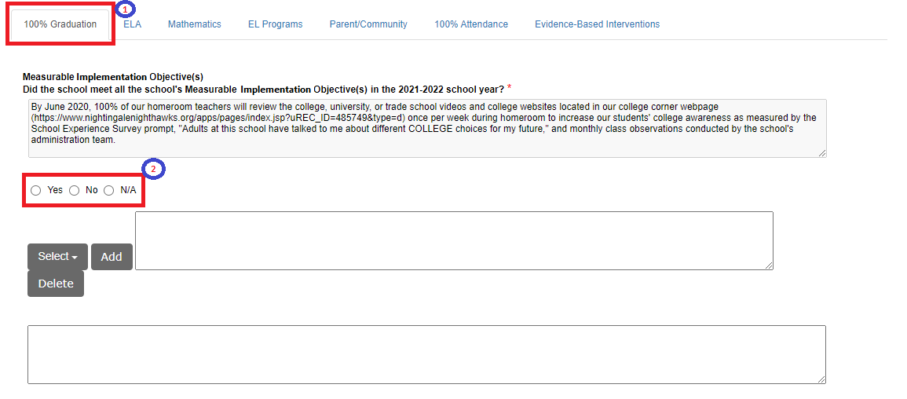
Select each tab with one or more Measurable Implementation Objective(s) and/or Measurable Improvement Objectives.
For each type of Measurable Objective listed select the appropriate response as, “Yes”, “No”, “N/A”.

Slide 11
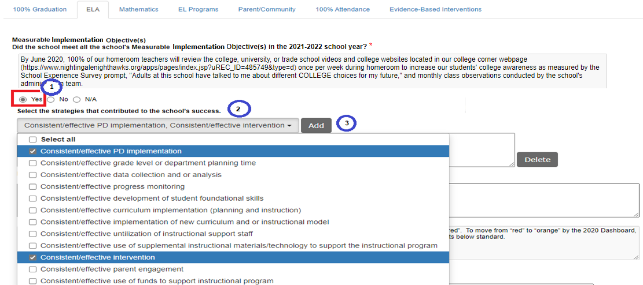
If “Yes” is selected.
Select one or more strategies that contributed to the school’s success from the drop-down list selections.
Click on the “Add” button.
NOTE: The “Add” button will move to the right as the school adds additional selections, due to long sentences. Use the scroll bar at the bottom of the page to move to the right and locate the “Add” button. Click the “Add” button to display selections.

Slide 12
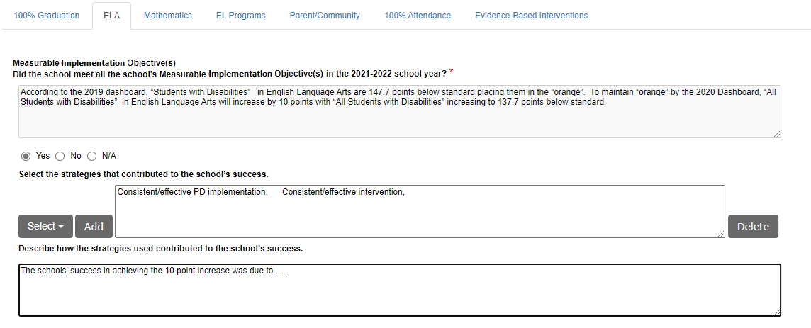
Type in the textbox, “Describe how the strategies used contributed to the school’s success”.

Slide 13
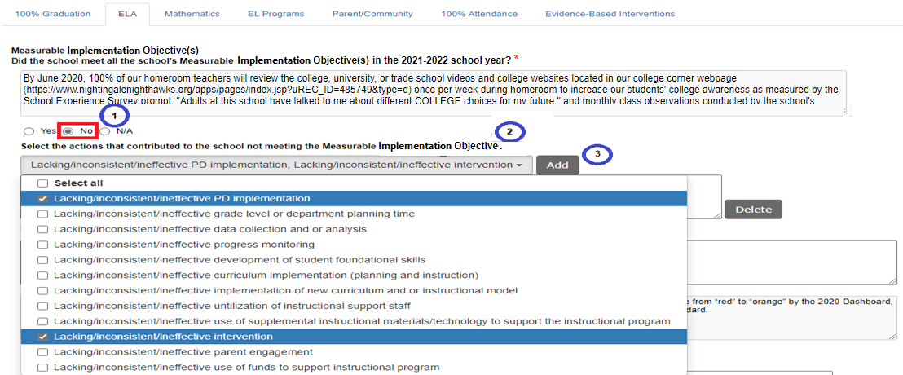
If “No” is selected.
Select one or more actions that contributed to the school not meeting the Measurable Implementation Objective from the drop-down list selections.
Click on the “Add” button.
NOTE: The “Add” button will move to the right as the school adds additional selections, due to long sentences. Use the scroll bar at the bottom of the page to move to the right and locate the “Add” button. Click the “Add” button to display selections.

Slide 14
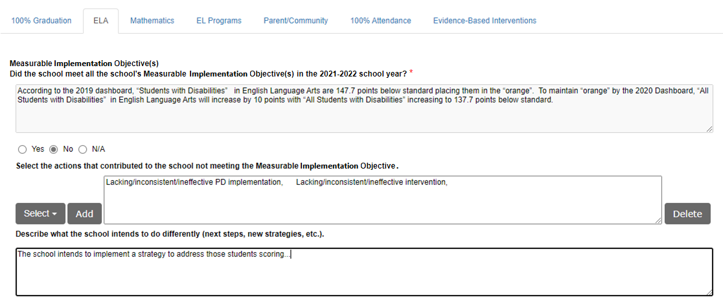
Type in the textbox, “Describe what the school intends to do differently (next Steps, new strategies, etc.)”.

Slide 15
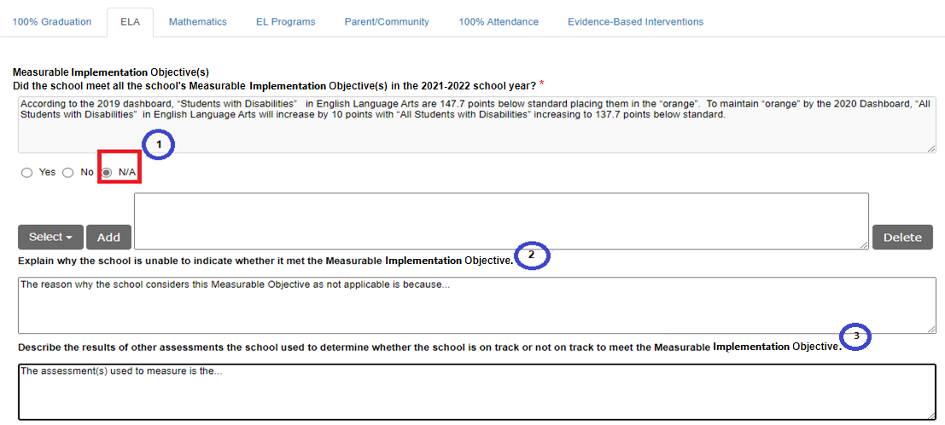
If “N/A” is selected.
Type in the textbox, “Explain why the school is unable to indicate whether it met the Measurable Implementation Objective”.
Type in the textbox, “Describe the results of other assessments the school used to determine whether the school is on track to meet the Measurable Implementation Objective”.

Slide 16
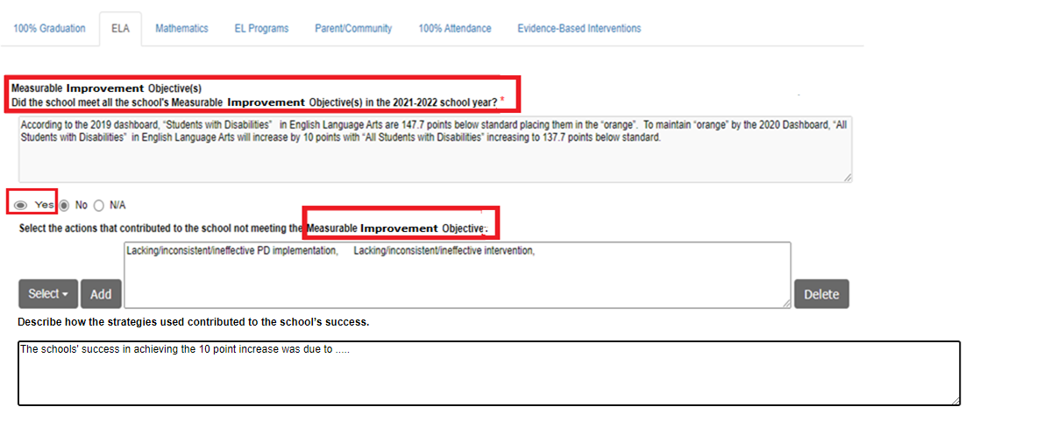
If “Yes” is selected.
Select one or more strategies that contributed to the school’s success from the drop-down list selections.
Click on the “Add” button.
NOTE: The “Add” button will move to the right as the school adds additional selections, due to long sentences. Use the scroll bar at the bottom of the page to move to the right and locate the “Add” button. Click the “Add” button to display selections.

Slide 17
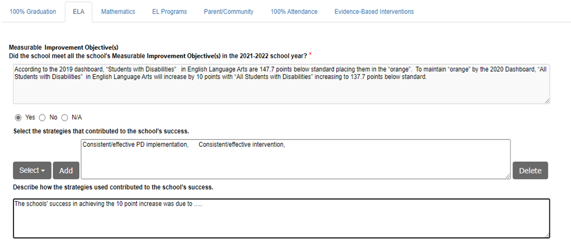
Type in the textbox, “Describe how the strategies used contributed to the school’s success”.

Slide 18
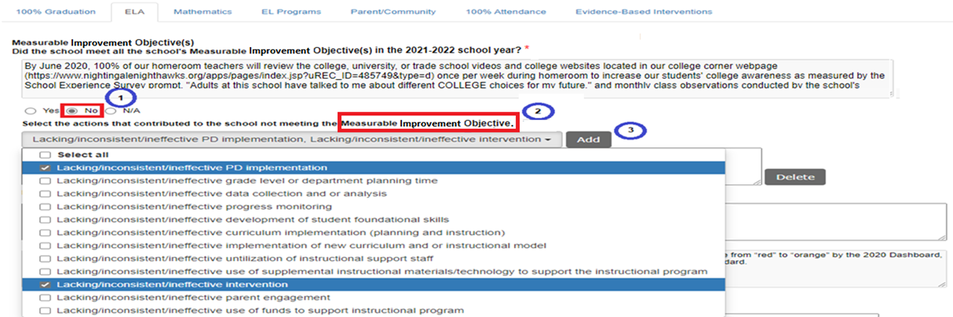
If “No” is selected.
Select one or more actions that contributed to the school not meeting the Measurable Improvement Objective from the drop-down list selections.
Click on the “Add” button.
NOTE: The “Add” button will move to the right as the school adds additional selections, due to long sentences. Use the scroll bar at the bottom of the page to move to the right and locate the “Add” button. Click the “Add” button to display selections.

Slide 19
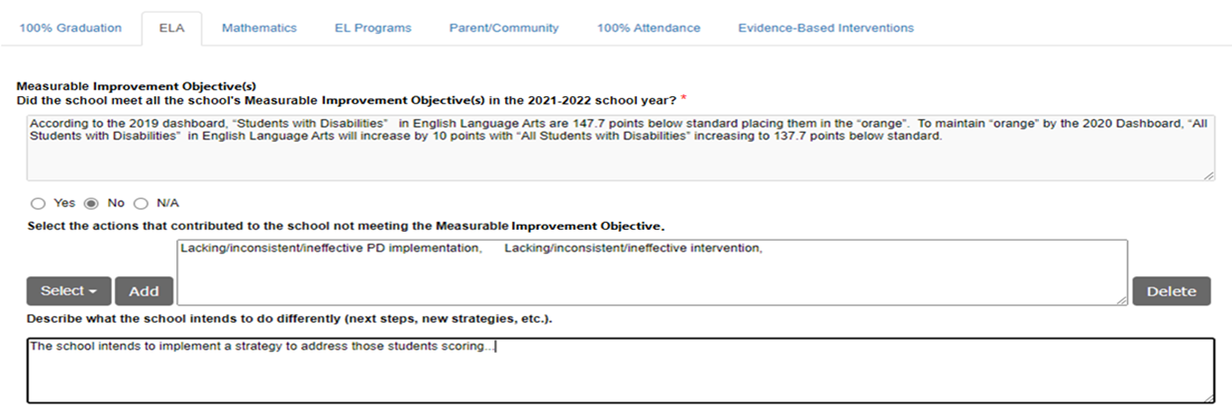
If “No” is selected.
Type in the textbox, “Describe what the school intends to do differently (next Steps, new strategies, etc.)”.

Slide 20
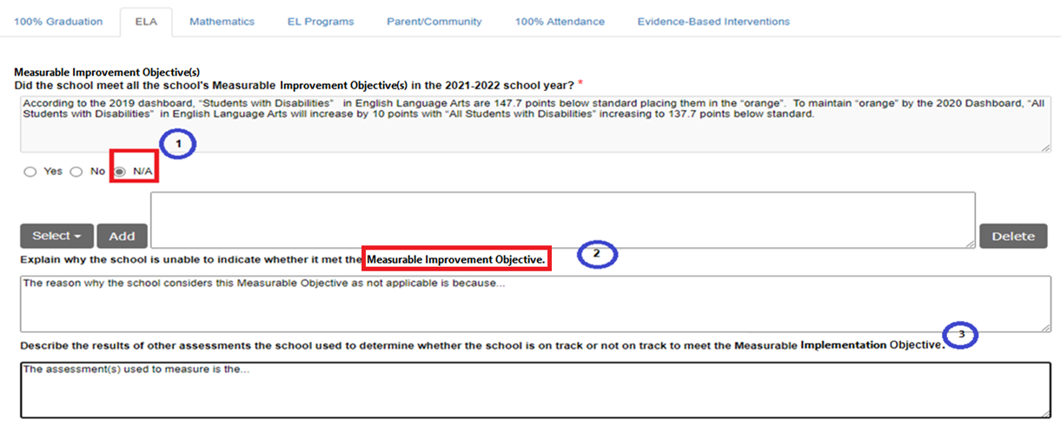
If “N/A” is selected.
Type in the textbox, “Explain why the school is unable to indicate whether it met the Measurable Improvement Objective”.
Type in the textbox, “Describe the results of other assessments the school used to determine whether the school is on track to meet the Measurable Improvement Objective”.

Slide 21

After the last Measurable Improvement is listed type in the textbox, “What implications do these results have for next year’s SPSA Plan?”

Slide 22
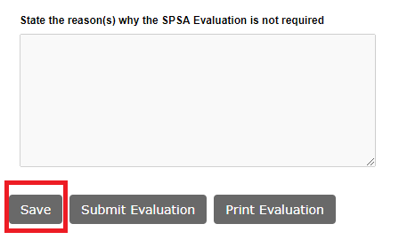
To save changes, click on the “Save” button.

Slide 23
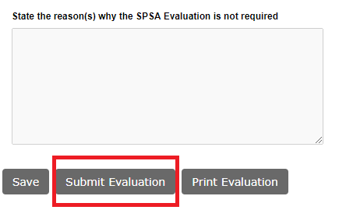
When the school has completed all the Goal tabs and the Evidence-Based Interventions tab in the SPSA Evaluation, click on the “Submit Evaluation” button to receive the green checkmark on the SPSA Evaluation left-navigation menu tab.

